Slide 1

Sage FutureMakers
Day 1
Notes:
Today, we are going to learn about the mysterious world of AI that actually stands for Artificial Intelligence. AI is a field of study which tries to make computers "smart". John McCarthy, an American Scientist famous for his work in the field of logic, came up with the term "artificial intelligence" in 1955.

Slide 2
Icebreaker: Siri Game
Instructions: One of the trainers should play Siri, the voice assistant in your smartphone. The other trainer should demonstrate how to play this game by asking the person playing Siri a simple question. Then students are invited to take their turn and ask Siri their questions, for example something like: “What is the weather today.”
Notes:
First, let’s play a simple game to get to meet each other and together we can demystify AI.
Instructions for the game:
One of the trainers should play Siri, the voice assistant in your smartphone. It could also be Alexa, the smart home assistant from Amazon. The other trainers should start by asking Siri person a simple question like: “Hi {Siri}! What is the weather today.” And the person who plays Siri should reply in a funny “mechanic” voice, using very plain logic and a bit of humour. Then students should be invited to take their turn. The answers and voice of Siri person should improve over time and become much more human-like.
After the game is finished, you need to give a little bit of explanation:
This is a simple demonstration of AI. The AI that we all interact with on a daily basis. It learns from our answers and improves over time. That is why, AI is also the ability of a computer program to think and learn - just like you do it everyday at school. It can be used to help us make life a bit easier, but it can also be used to solve some real challenges facing humanity like healthcare and poverty.

Slide 3
Funny Siri dialogue examples
Hey Siri, my name is Bobby! [use any other funny name that can be mispronounced]
Hi Barbie, what a beautiful name. My name is Siri - nice to meet you!
No Siri, my name is not Barbie - it is Bobby
Sorry, I can’t process your request this time, please try again later...
Hey Siri, you need to do a better job of understanding me
Noted
Yeah, make a note of that
Here’s your note: Note of that!
Hey Siri, do you have a boyfriend?
Why? So we can get ice cream together, listen to music, and travel across galaxies, only to have it end in slammed doors, heartbreak and loneliness? Sure, where do I sign up?
Hey Siri!
What I can help you with?
Play some cool music please?
You don’t have any ‘cool” music
Hey Siri, what are you wearing
Aluminosilicate glass and stainless steel. Nice, huh?
Hey Siri, I’m tired
Listen to me. Put down this phone right now and take a nap. I’ll wait here
Hey Siri, what is the meaning of life?
All evidence to date suggests it’s chocolate
[to Siri] Hey Alexa!
Very funny, Barbi. I mean not funny “ha-ha,” but funny.
Notes:
Important: you don’t need to show this slide to the students!
Here are the examples of the dialogues you can play to make it funny and engaging for students.

Slide 4
Plan for today:
09:00-09:15 Icebreaker Siri game & Introduction
09:15-09:30 UN Sustainable Development Goals (SDGs)
09:30-12:00 Workshop Session I: Coding skills
12:00-12:45 Lunch break
12:45-13:00 AI Ethics Game & Youtube example
13:00-15:00 Workshop Session II: AI tools & APIs
15:00-15:15 Human Centered Design & AI for Good Examples
15:15-16:00 Design Workshop: Your AI for Good Solution
16:00-17:00 Presentations
Notes:
In terms of the plan for today:
We are going to have 2 workshop sessions with a lunch break in the middle, as well as 3 brief lessons on the UN Sustainable Development Goals, AI ethics and product design. In the last hour we are going to spend brainstorming ideas for AI for Good applications and finish with a presentation of your amazing work!

Slide 5
Trainers
Photo
Photo
Photo
[Name Surname]
[Expertise]
[Name Surname]
[Expertise]
[Name Surname]
[Expertise]
Photo
Photo
[Name Surname]
[Expertise]
[Name Surname]
[Expertise]
Notes:
Introductions:
Please introduce your team and who is responsible for the technical and for the non-technical questions, so students know whom to approach and why?

Slide 6
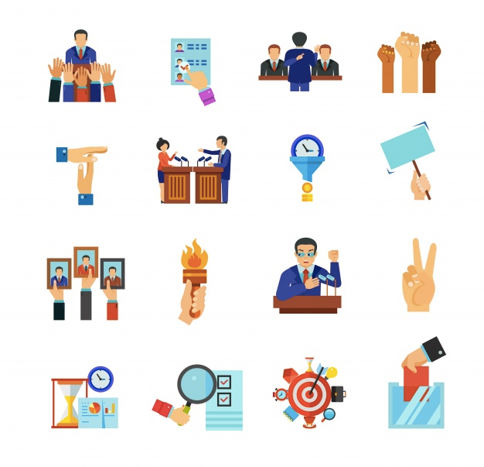
So what can (A)I do?
Skills & Passion
AI Tools
FutureMakers
Real World Problems
AI for Good Solutions
Notes:
The goal of today…
Is teach you new skills on how to use AI, the key task for you is to apply your creativity and passion to solve real problems. We will give you tools to do it and then you can come up with your innovative AI for Good solution and present it to us!

Slide 7
UN Sustainable Development Goals
(SDGs)
Notes:
Now, let’s learn about what problems we can help solve with AI.

Slide 8

The list of 17 Global Goals
17 SDGs
No Poverty
Zero Hunger
Good Health and Well-being
Quality Education
Gender Equality
Clean Water and Sanitation
Affordable and Clean Energy
Decent Work and Economic Growth
Industry, Innovation, and Infrastructure
Reducing Inequality
Sustainable Cities and Communities
Responsible Consumption & Production
Climate Action
Life Below Water
Life On Land
Peace, Justice & Strong Institutions
Partnerships for the Goals
Notes:
The list of 17 goals and why do they matter:
The 2030 Agenda for Sustainable Development was adopted by all the United Nations member states in 2015. It provides a shared blueprint for peace and prosperity for people and the planet, now and into the future. At its heart are the 17 Sustainable Development Goals (SDGs), which are an urgent call for action by all countries - developed and developing.
In essence, this is a list of global challenges that we as a society need to solve in the next 10 years in a global partnership and using technology tools such as AI. You can use this list of challenges to build an AI solution that addresses a real world problem and helps real people that suffer from this problem.

Slide 9
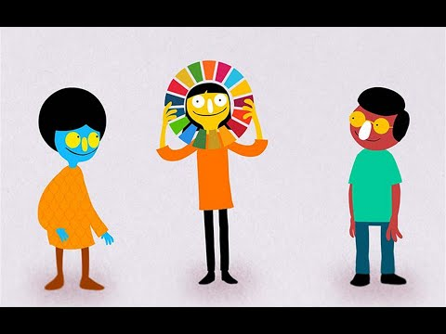
SDGs made simple
The 2030 Agenda for Sustainable Development, adopted by all United Nations Member States in 2015, provides a shared blueprint for peace and prosperity for people and the planet, now and into the future.
At its heart are the 17 Sustainable Development Goals (SDGs), which are an urgent call for action by all countries - developed and developing - in a global partnership.
https://youtu.be/cBxN9E5f7pc
Notes:
Explaining the goals:
Let me show you a short video with Emma Watson (the actress that played Hermione in the Harry Potter film series) giving very illustrative examples of the Sustainable Development Goals: https://youtu.be/cBxN9E5f7pc [play a video on the screen]

Slide 10
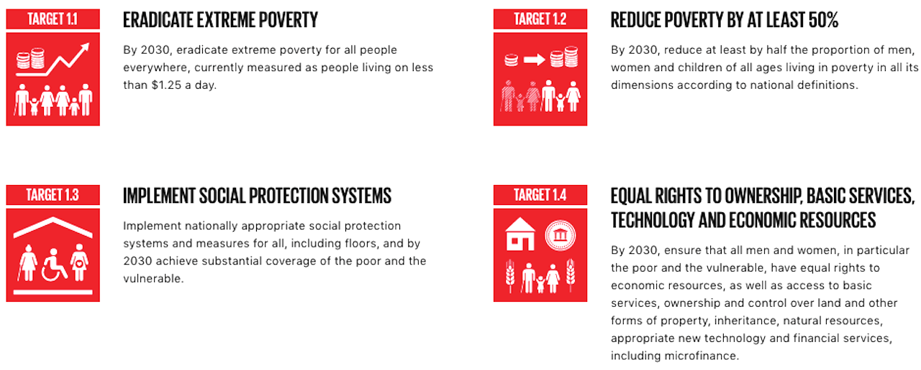
SDG #1: No Poverty - Targets
Notes:
[If you have time] you can also show students this website: https://www.globalgoals.org/. Point to the fact that each SDG has a list of targets that can help them focus on a smaller issue within the problem rather than on the entire problem which is usually hard to solve at once. For example, SDG #1 about poverty has these targets that can be measured: https://www.globalgoals.org/1-no-poverty [scroll down to “targets”]. These targets give students a more realistic idea on how to solve the bigger problem of poverty and where to start.

Slide 11
Workshop Session 1:
Part A - Coding Skills
> Open Workshop Manual
Notes:
Ok, time to get to some actual coding:
In session 1 you are going to learn some basic coding skills in Python. Please open your laptops and the workshop manual [should be on their table]. Please follow the instructions there to complete exercises available in Part A.

Slide 12
Lunch Break
Notes:
Ok, we worked hard and deserve a break. It’s time to have lunch. You will have 30-45 minutes and after we reconvene.

Slide 13
AI Ethics Game
Instructions: Each student / trainer writes their name and an interesting random fact, something unique that no one knows about them, on a piece of paper and crumples it into a ball. Ideally, all participants should stand in a circle. When everyone has their paper ball ready, have them toss them back and forth around the room until the leader then yells “Stop!”, so no one knows whose ball they are holding. Each participant unfolds the paper ball they are holding and reads out loud what is written there.
Notes:
Before we start with Session 2, let’s play another game to make you move a little bit.
Instructions for the game: Each student and trainer writes their name and an interesting random fact, something unique that no one knows, about them on a piece of paper and crumples it into a ball. Ideally, all participants should stand in a circle. When everyone has their paper ball ready, have them toss them back and forth around the room until the leader then yells “Stop!”, so no one knows whose ball they are holding. Each participant unfolds the paper ball they are holding and reads out loud what is written there, introducing the person whose paper they are holding.
After the game is finished, you need to give a little bit of explanation: You were all probably a bit surprised to learn some new things about each other. It’s because all of us have prejudice and even though we don’t know a person well enough, we can already derive some assumptions about this person from the way they look or talk. AI does the same thing it generalises the information it has available about people and puts them in different categories, to predict their behaviour and preferences. This can also lead to bias if the amount of information about specific category is unavailable. For example, it can put all women in the category of high-risk drivers by default, because in the information that was used to train this AI there wasn’t enough examples of good female drivers. This can result in unfair treatment and toughened requirements for women to pass driving tests, hence increasing gender inequality. This is why bias in AI are unfair and unethical.

Slide 14

Youtube decides what you see
In the case of Youtube or other social media, bias isn’t the biggest concern.
The bigger issue is that their AI isn’t designed to help you get what you want — it can get you addicted to things you see like “funny cat videos”. Their AI is trained to make recommendations that keep you on the platform for as long as possible.
Another big issue is privacy, as data collected about users can be leaked and used by bad actors.
Notes:
Youtube example:
AI used in Social Media platforms puts you in a certain category and makes you see things to reinforce your pre-existing views, like political leaning or other social preferences you expressed whilst interacting with the content previously. The recommended content can trap you in a vicious cycle of non-stop videos that don’t add any value to your life. It is actually designed to grab your attention away from the really important things like study or work, or concentration on a particular task. And there's serious cost to this, because every time we interrupt, it takes us about 23 minutes, on average, to refocus our attention.
To summarise, in your solution - you should consider such ethical questions around AI as bias, fairness, privacy and addiction.

Slide 15
Workshop Session 2:
Part B - AI Tools & APIs
> Open Workshop Manual
Notes:
Ok, back coding:
In session 2 you are going to learn about various AI cognitive services such as language translation, voice synthesis and object recognition. Please open your laptops and the workshop manual [should be on their table]. Please follow the instructions there to complete exercises available in Part B.

Slide 16
Human Centered Design
(HCD)
Notes:
Human Centered design:
Human centered design is an approach to problem solving that is based on involving the human perspective in all steps of the process.

Slide 17
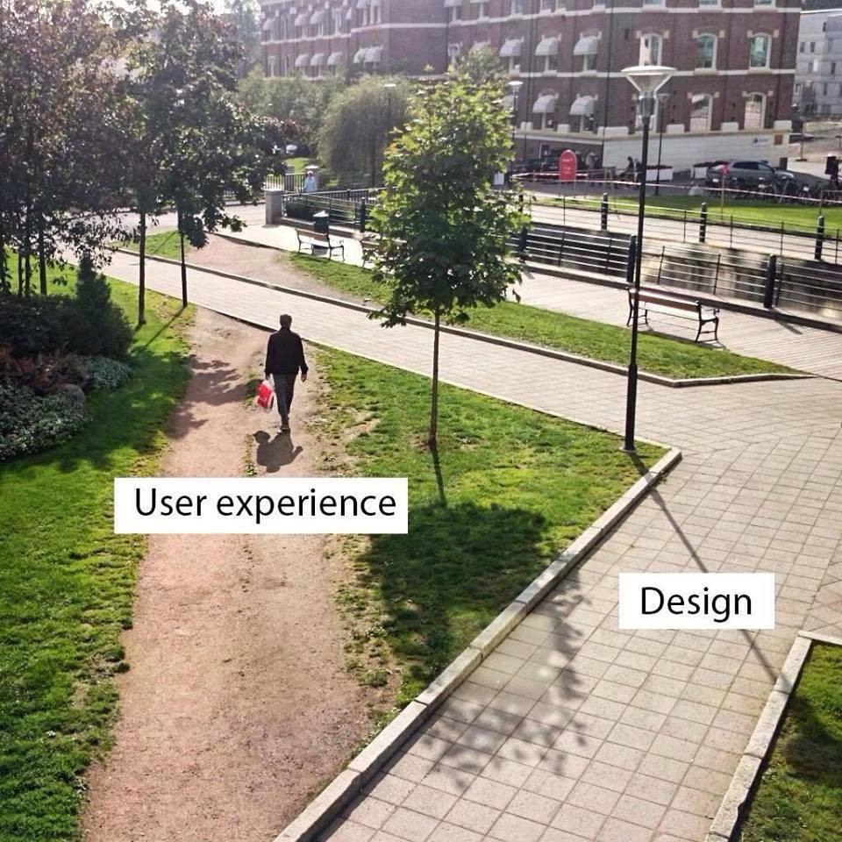
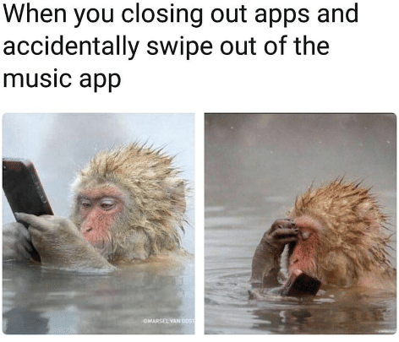
Poor vs. Good design
Notes:
Let me give you a quick example:
On the left hand side, you see a picture of pedestrian pathway as designed by an architect and as used by an actual pedestrian. This is an example of poor design. It's human to shortcut and the architect clearly didn’t consider the need of pedestrians to save time.
On the right, you clearly see an example of good design. Which is so good that not only humans, but also animals can use this it so intuitively. It is, however, not the best design for this particular type of Japanese snow monkey that sits in hot springs all day and can easily drop the phone in the hot water.
Then ask students what other examples of good and poor design do they know?

Slide 18



Human Centered Design (HCD)
Put human at the heart of your design:
Listen them actively
Understand problems
Emphasise with them
Put yourself in their shoes
Research their needs
Include in the process
Treat users as an equal, not dependent, include them in the process:
Notes:
It is important that you design your AI solution around the human. Without humans, no change for the better is possible.
Put human at the heart of your design process by carefully listening and emphasising with them, researching their needs.
Treat your user as an equal, as if you are trying to help you friend or a relative - include them in the design process.

Slide 19
Human Centered Design (HCD)
Make sure there’s an actual need for your solution and that it is accessible and feasible:
This is where you want your solution to be
ACTUAL NEED
What do people actually need?
FEASIBILITY
What is technically and organizationally feasible?
ACCESSIBILITY
What is financially, physically, mentally accessible?
Notes:
Make sure these 3 things are aligned in your solution:
make sure your solution addresses the actual need of the real people;
accessibility - make sure all your users have access to your solution, but not only physically but mentally and financially as well;
feasibility - think about the way your are going to build it, do you have enough skills and resources, what about the logistics?

Slide 20
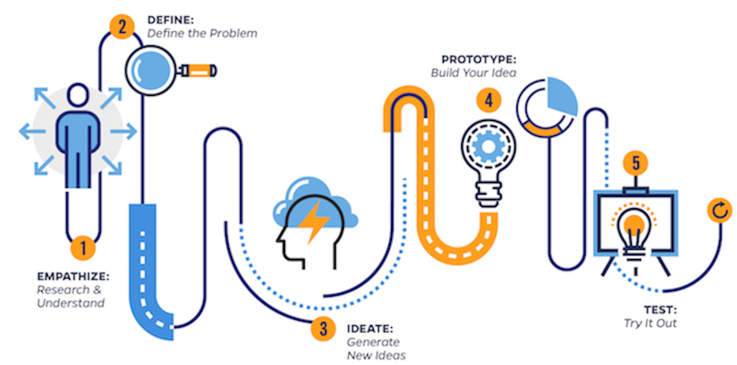
HCD is a process
Notes:
Human Centered Design process:
Finding a solution for any given problem is always an iterative process, because after you:
understand your user’s needs,
define the specific problem,
generate an innovative idea on how to solve it
and build a prototype of your solution
you still need to test it with your users to see if they are willing to use it or not.
Then you feed back the results of your user testing back into the process. This way you make sure the solution you design is going to be adopted by the people that need it the most to make the change happen. Otherwise, event the most innovative solution will not be used and hence will have no impact on the problem.

Slide 21
AI for Social Good:
Examples
Notes:
What could be a good example of AI for Good or AI that solves an important societal problem? Do you know of any?

Slide 22
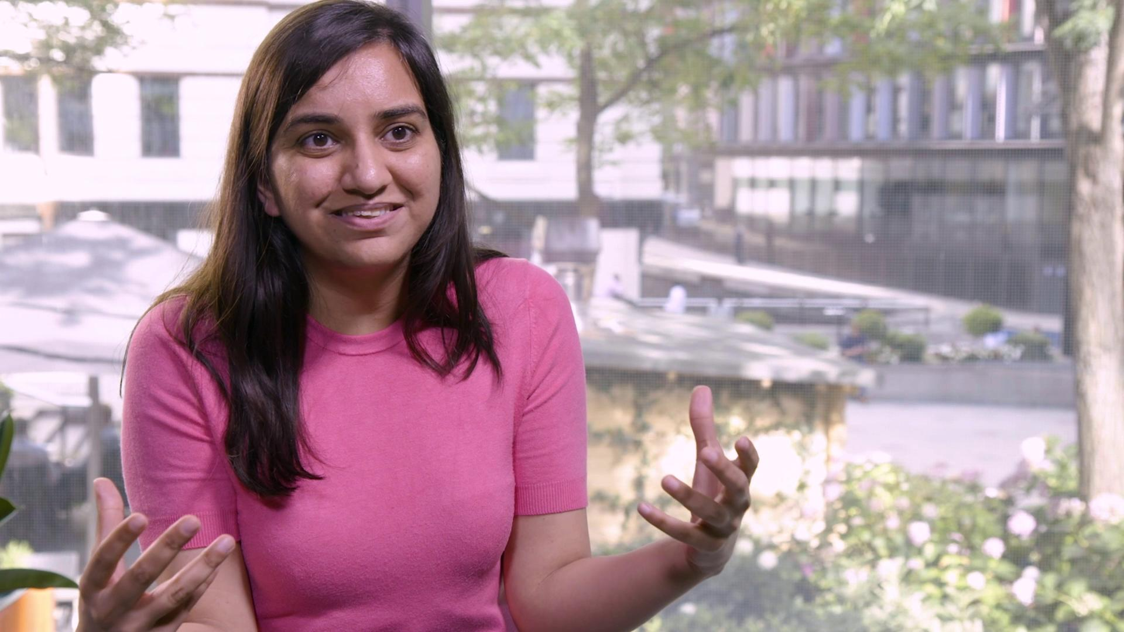
AI for Good champions
A short video of some incredible people working on AI for Good projects.
They will be talking about their journey and how they came up with their creative ideas to solve real world problems.
We hope they will inspire you to create something similar today!
Notes:
Good for you, we prepared a video with some of amazing AI for Good Champions talking about the projects they work on:
________________ [we’ll add the link to the updated video later]

Slide 23
AI for Good examples
Earlier solutions by young people have included:
A mental health support tool for gamers
Recycling competition using object recognition
A marine biodiversity catalogue
A companion for the elderly who live alone
A personalised tutor for children who do not have access to quality education
Climate change impact modelling
Personalised recommendations to reduce your carbon footprint
Algorithmic solutions to reduce hunger by eliminating food waste
An accessibility solution for the visually impaired using video analysis and image recognition
Notes:
Here are more examples of what AI for Good ideas other students have come up with earlier this year! To give you more details on a couple of these solutions:
Mental Health Support for Gamers. Problem: gamers become physically and mentally exhausted after hours of non-stop playing (tied to UN Sustainability Development Goal #3). Solution: an activity monitoring system embedded in the game that tracks how much you play against your activity cycle, so that it can stop you from playing even in the middle of the game and encourage you to do some exercise. It rewards you with bonus points for healthy physical activity.
Recycling competition using object recognition. Problem: sometimes people don’t know what is recyclable and forget to do it (SDG #11-12). Solution: a scanning system for detecting recyclable objects that works at the shop till, and the competition website. Scanning an item earns points on your account, free advice on about how to reuse or recycle the product, and information about how you can make a difference by recycling properly. It is also linked to an Instagram challenge to encourage people to recycle more.
Marine biodiversity catalogue. Problem: 3 billion people depend on marine and coastal biodiversity as the world’s largest source of protein, whilst uncontrolled fishing leads to the rapid depletion of many fish species (SDG #14). Solution: a public catalogue of marine species using image recognition. People can take pictures of various fish and other underwater species, upload them to a website, label and store in the catalogue. They earn points to donate food to people who are most dependent on the ocean. If they don’t know what a species it is, the smart image recognition system will suggest some options.

Slide 24
Design Workshop:
Your AI for Good solution
Notes:
Now it’s time for you to start creating your AI for Good solution.
Just remember the following rules:
Find the real problem to solve (one of the SDG’s)
Put human at the heart of your process
Research, understand and emphasise with your user to better define their needs and the problem
Generate ideas and capture them somehow
Consider ethics of implementing your solution
Build a project around your solution
Prepare a quick presentation and pitch your creative idea to us!

Slide 25
Presentation Skills:
Storytelling
Notes:
Before you start working on your presentation of the solution you designed today, here are some suggestions to help you tell an engaging story with your presentation.

Slide 26
Storytelling: questions
Problem: What problem are you trying to solve?
Argument: So what? Why do you think it matters?
User persona: Who are the people that suffer from this problem the most? What is a day of their life look like now?
Impact: How big is the impact? How would it change these people’s lives?
SDG’s: Is this problem part of the UN Sustainable Development Goals?
Alternatives: What are the current solutions and why are they not effective enough?
Your idea: What is your solution and how does it solve the problem? How is it different from existing solutions?
Human-centred design: What do people actually need? What is financially viable for them? What is technically and logistically feasible?
Ethics: What ethical risks have you identified and how did you address them?
Sustainability: What is the long-term ambition for your tech? Is it compatible with standard approaches? Can it be scaled across different spheres / countries?
Notes:
It is not necessary to explain this in detail, as this is included in the manual. Perhaps just highlight the most important questions they should cover in their presentation, like the problem, the user, the solution and how it works.

Slide 27
Presentations:
Showcase your idea!
Notes:
Time for presentations

Slide 28

Thank-you

Slide 29
Appendix:
For trainers only!

Slide 30
Why FutureMakers?
The world is constantly changing as we grow older: we are living through the 4th Industrial Revolution where Automation and Artificial Intelligence are changing the nature of work and how we are going to collaborate in the future.
30% of today’s jobs will be gone by the 2030s: a new set of skills will be required in the future and you need to anticipate and choose carefully which skills to develop.
FutureMakers course is an opportunity for young people to embrace these changes and get yourself prepared for the job that doesn’t exist yet.

Slide 31
Why for young people?
In 1 in 4 young people in UK are considering a future career in AI
Of the young people not considering a career in AI, most say they would prefer a more creative career
34% of young people in the UK think AI is a force for good and can help solve the world's problems
Talent pipeline spearheaded by young people wanting to work at the cutting edge of technology
Over 1/2 of young people* don’t think Hollywood depicts AI correctly

Slide 32
Course objectives
Inspire youth from underserved communities to engage in AI education
Address changing workforce challenges due to the impact of automation
Introduce and champion a new set of skills that will be required by businesses for jobs that don’t currently exist
Train the next generation in the development of ethical, responsible technology
Leverage applications of AI to accelerate progress towards the UN Sustainable Development Goals
Commit to the following stakeholders: Young People (13-17), Teachers, Parents, Caregivers, Charity Partners, Volunteers, Local Government

Slide 33
Ethics: Responsible Technology
Responsible technology:
is designed with security, privacy and safety in mind
does NOT (knowingly) deepen existing vulnerabilities and inequalities, or create new ones
protects existing democratic and human rights
is made by teams of individuals from diverse backgrounds that are mindful of their ethical, social and human impact
has controls in place to react to and guard against unintended consequences

Slide 34
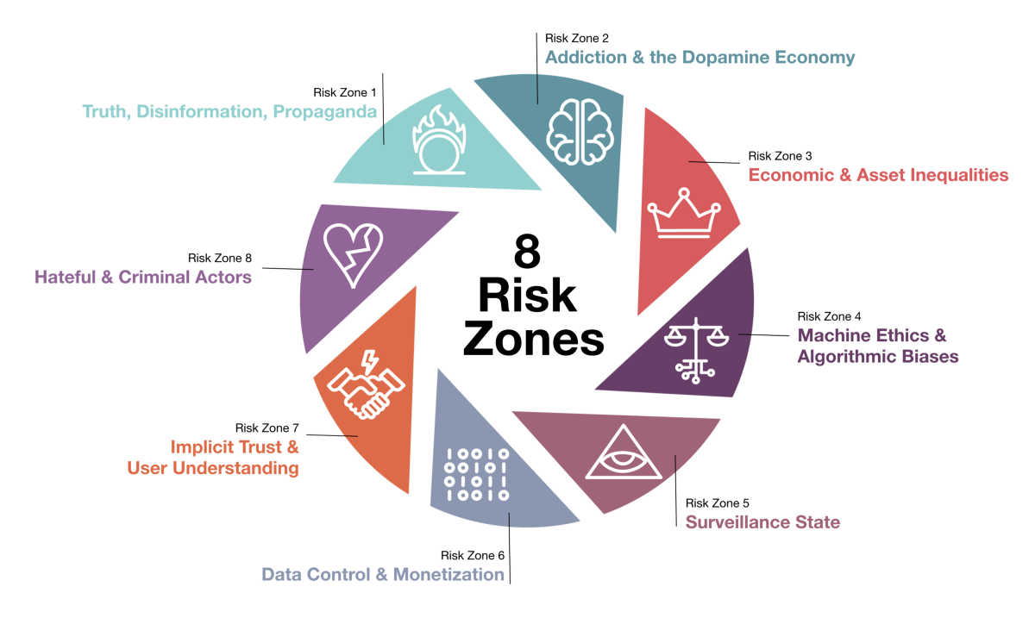
Ethics: Risk Zones

Slide 35
Ethics of code
AI should reflect the diversity of the users it serves: As an industry and tech community we must develop effective mechanisms to filter our bias as well as any negative sentiment in the data that AI learns from and ensuring AI does not perpetuate stereotypes.
AI must be held to account: AI needs to be held accountable for its actions and decisions, just like humans. Technology should not be allowed to become too clever to be accountable.
Reward AI for ‘showing its workings’: Any AI system learning from bad examples could end up becoming socially inappropriate—we have to remember that most AI today has no cognition of what it is saying. Only broad listening and learning from diverse data sets will solve for this.
AI should level the playing field: AI provides new opportunities to democratize tech, especially because of its ability to scale. AI community needs to accelerate the development of accessible solutions to level the playing field and broaden the talent pool.
AI will replace, but it must also create jobs: There will be new opportunities created by the automation of repetitive, mundane tasks by AI, so people can focus on what they are good at, e.g. building relationships, empathy and problem-solving.

Slide 36
Human Centered Design: Principles
Equitable Use: The design does not disadvantage or stigmatize any group of users.
Flexibility in Use: The design accommodates a wide range of individual preferences and abilities.
Simple, Intuitive Use: Use of the design is easy to understand, regardless of the user's experience, knowledge, language skills, or current concentration level.
Perceptible Information: The design communicates necessary information effectively to the user, regardless of ambient conditions or the user's sensory abilities.
Tolerance for Error: The design minimizes hazards and the adverse consequences of accidental or unintended actions.
Low Physical Effort: The design can be used efficiently and comfortably, and with a minimum of fatigue.
Size and Space for Approach & Use: Appropriate size and space is provided for approach, reach, manipulation, and use, regardless of the user's body size, posture, or mobility.

Slide 37
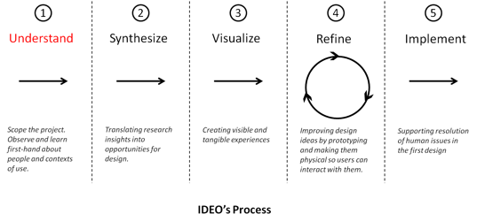
Human Centered Design: Approach

